Slide 1
Lesson 3
Introduction to CSS

Slide 2
What will we learn today?
What is CSS?
Inline/Internal/External CSS
CSS Syntax
id & class attribute in HTML and CSS
Common CSS Properties
Activity

Slide 3
What is CSS?

Slide 4
What is CSS?
Stylesheet language
Style an HTML document
Cascading Style Sheets
Can control the layout of multiple web pages at once
Describes how HTML elements are supposed to be displayed
Define design, layout, and variations for different screen sizes
Separate content from the presentation (visual aspect)

Slide 5
Inline, Internal, External CSS

Slide 6

Inline CSS
We have already used it before!
Unique style for a single element
Use the style attribute

Slide 7
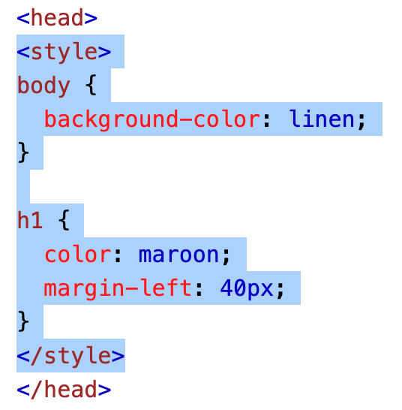
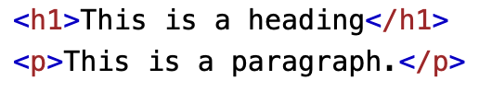
Internal CSS
Can be used if one single HTML page has a unique style
Defined inside the <style> element, inside <head>
Write this code in the <head> section. Then, in <body>, write this:

Slide 8
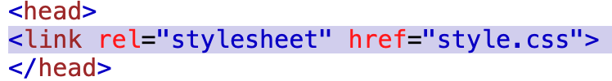
External CSS
All of the style is in a .css file
Any HTML page that uses external CSS needs to refer to that .css file, inside <link> element, inside <head> section

Slide 9
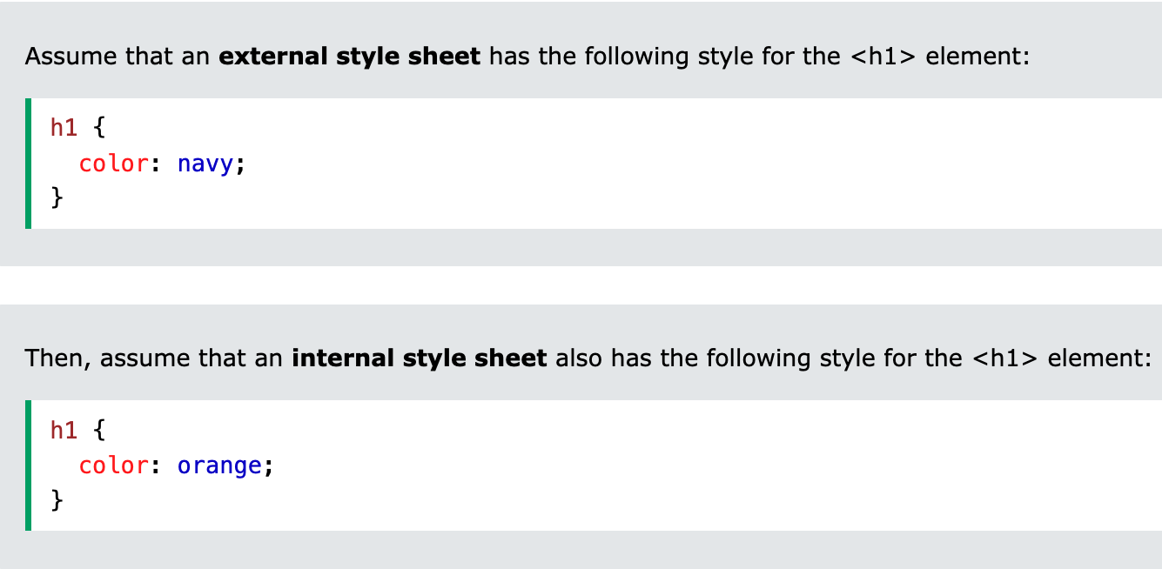
Hierarchy
W3schools: “If some properties have been defined for the same selector (element) in different style sheets, the value from the last read style sheet will be used.”
If internal style is defined after the link to the external style sheet
If internal style is defined BEFORE the link to the external style sheet

Slide 10
CSS Syntax

Slide 11
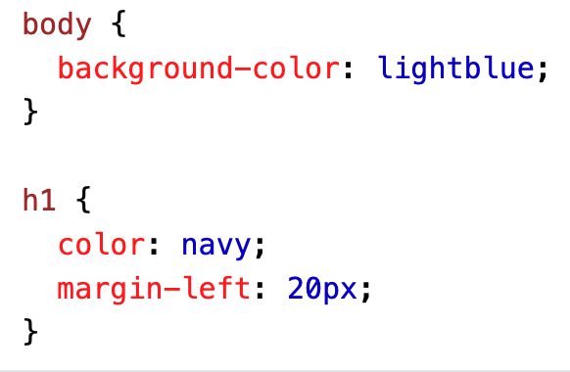
CSS Syntax
brackets
selector {
property: value;
}
semicolon
brackets

Slide 12
id & class attributes

Slide 13
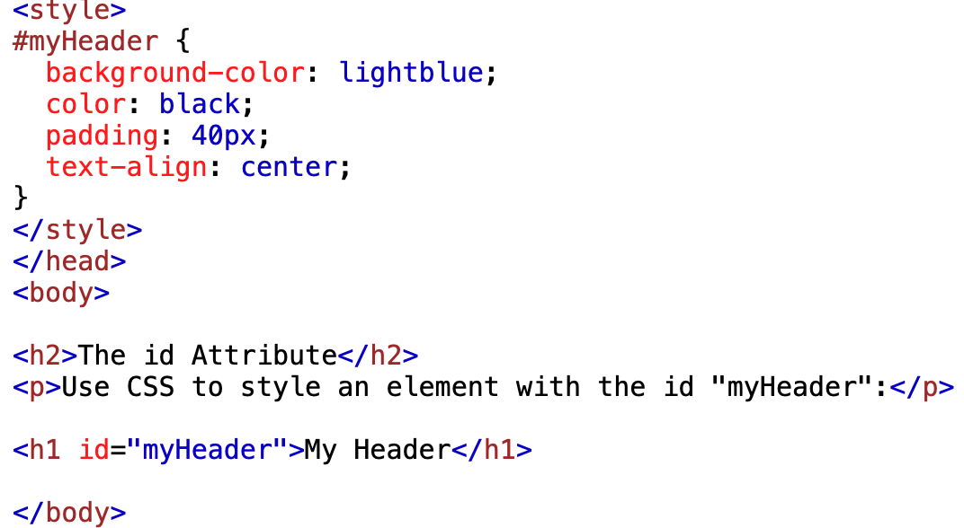
id attribute
Specifies a unique ID for a HTML element
Can’t be the same as another value in another id attribute
Used to point to a specific style declaration in a style sheet
Example
Use # to refer
to it in CSS

Slide 14
class attribute
Point to a class name in a style sheet
For groups of elements
w3schools.com: “In the following example we have three <div> elements with a class attribute with the value of "city". All of the three <div> elements will be styled equally according to the .city style definition in the head section.”
Refer to it in CSS with a period. I.e.: .className
Example

Slide 15
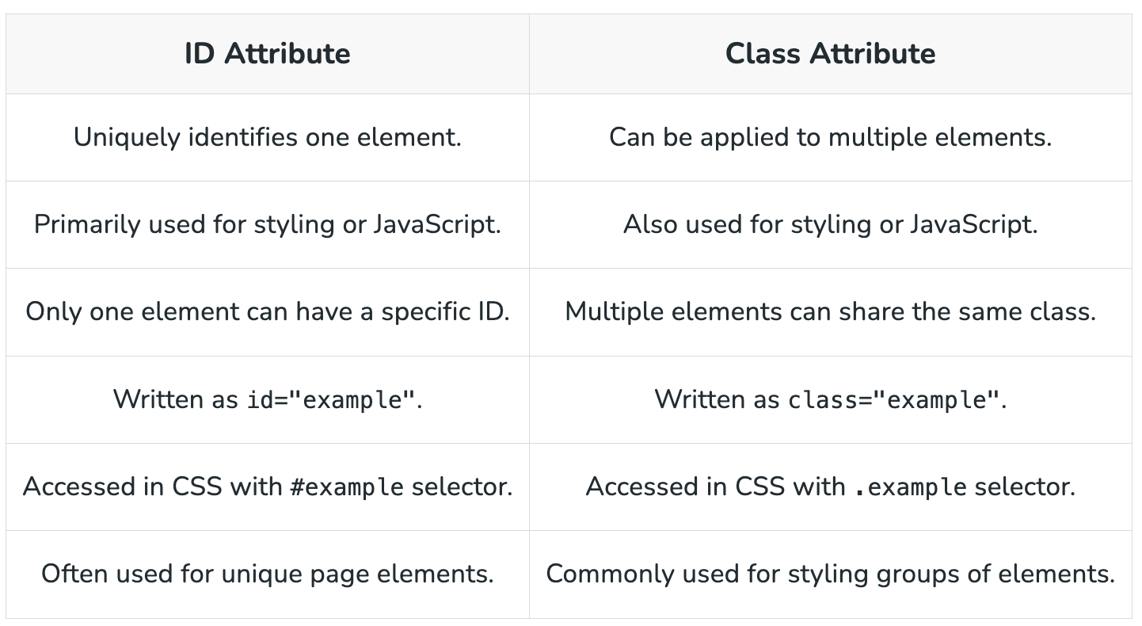
id vs class Attribute (Ex.)

Slide 16
Common CSS Properties
You can use this color picker or google “color picker” to find the exact hex code.

Slide 17
Text Styling
color: Text color.
font-family: Font type.
font-size: Font size.
font-style: Italics.
font-weight: Boldness.
text-align: Alignment (left, center, right, justify).
text-decoration: Underline, overline, line-through, none.

Slide 18
Backgrounds
background-color: Background color.
background-image: Background image.
background-repeat: Repeat pattern (repeat, no-repeat, repeat-x, repeat-y).
background-position: Position of the background image.

Slide 19
Box Model
width and height: Dimensions of an element.
padding: Space inside the border of an element.
border: Border properties (width, style, color).
margin: Space outside the border of an element.

Slide 20
Classwork

Slide 21
Apply basic CSS properties to style an HTML document
Create a simple HTML file with some text elements.
Style the elements using an internal CSS block.
Instructions
Complete the following tasks within the <style> tag:
Change the background color of the page to light grey.
Set the text color of the title (h1) to dark blue and center-align it.
Make the introductory paragraph (.intro) text size 18px and color dark green.
Add a yellow background color to the note (.note) and set its text to bold.

Slide 22
Copy this code for the activity:
<!DOCTYPE html>
<html>
<head>
<title>CSS Classwork Activity</title>
<style>
/* Add your CSS here */
</style>
</head>
<body>
<h1 class="title">Welcome to My Page</h1>
<p class="intro">This is an introductory paragraph.</p>
<p class="note">Note: CSS is awesome!</p>
</body>
</html>

Slide 23
Solution (Example)
body {
background-color: lightgrey;
}
.title {
color: darkblue;
text-align: center;
}
.intro {
font-size: 18px;
color: darkgreen;
}
.note {
background-color: yellow;
font-weight: bold;
}

Slide 24
Homework - All About Me CSS

Slide 25
Activity: Add CSS to your All About Me page (Example)
You have a lot of freedom to express yourself and your design in this assignment.
Here’s what to style:
Headings (you can change the font if you want)
Text (paragraph) (you can change the font if you want)
Link(s) (need help with this part?)
Images (you can add borders, center the image, etc)
Background
Required: Make sure you’re using inline, internal, and an external stylesheet. Experiment with the hierarchy and what overrides what. See this slide
Extra Credit +5: style anything else, like headers/footers

Slide 26
Thanks & Happy Hacking!

